Slide 1


Implementation of an IT Network Scenario
Using Packet Tracer for Teaching and
Learning Purposes
Summited by
Tamilarasan M
(724020104022)
Siva R
(724020104019)
GUIDE:
Mr.R. GOWRISHANKAR AP/CSE

Slide 2
Abstract
In this paper, we present the implementation of a simulated IT network scenario using Cisco Packet Tracer for teaching and learning purposes. We describe the network topology and the configuration of devices such as switches, routers, and servers We also highlight the benefits of using Packet Tracer for teaching and learning computer networking concepts. Our implementation servers as an effective tool for students to gain hands-on experience with network design and configuration, troubleshooting, and security measures. The results of the implementation demonstrate the effectiveness of using simulation tools like Packet Tracer to facilitate the teaching and learning of computer networking concepts.

Slide 3
Objectives
To design and implement a realistic IT network scenario using Cisco Packet Tracer to provide hands-on learning experiences to students.
To describe the network topology and the configuration of network devices such as routers, switches, and servers.
Developing problem-solving skills: Students should be able to
develop problem-solving skills, critical thinking, and analytical skills by solving network-related challenges in the sim environment.

Slide 4
Literature Methodology
Paper Name | Author Name | methodology | disadvantage
College Network Scenario Implementation by using Cisco Packet Tracer | M. Hasan, M. S. Islam, and M. S. Alam | After configuring the devices, the network can be simulated using Packet Tracer. The simulation can be used to test the network's functionality, identify potential issues, and troubleshoot them. | The configuration process using Packet Tracer may differ from configuring real-world devices, which can make it harder to translate the knowledge gained from the simulation to practical applications.

Slide 5
Existing System
Traditional lecture-based instruction: In this approach, instructors typically deliver lectures on computer networking concepts using textbooks or presentation slides. Students may have limited opportunities for hands-on experience with network design and configuration.
Lab-based instruction: In this approach, students have access to physical network devices in a lab setting to gain hands-on experience with network design, configuration, and troubleshooting. However, this approach may be costly, time-consuming, and may not be easily scalable to large classes.

Slide 6
Disadvantages
Limited hands-on experience: Some traditional teaching methods may provide limited opportunities for hands-on experience with network design and configuration, which may limit students' ability to apply theoretical concepts in practice.
Limited scalability: Lab-based instruction, while providing hands-on experience, may be costly, time-consuming, and may not be easily scalable to large classes.
Limited accessibility: Physical lab setups may not always be accessible to students who are unable to physically attend classes due to distance, time constraints, or other factors.

Slide 7
Proposed System
Packet Tracer software: The core component of the system is the Packet Tracer software, which is used to simulate computer networks and network devices. It allows students to design and configure network topologies, test network configurations, and troubleshoot network issues.
Learning materials: The system also includes learning materials such as instructional videos, online tutorials, and lab exercises that are designed to help students learn computer networking concepts.
Assessment tools: The proposed system also includes assessment tools such as quizzes and exams to evaluate students' understanding of computer networking concepts.

Slide 8
Advantages
Hands-on experience: Use some advance teaching rather then the traditional teaching methods may provide more opportunities for hands-on experience with network design and configuration, which may give students' ability to apply theoretical concepts in practice.
Scalability: Lab-based instruction, while providing hands-on experience, less expense compare to previous , less time-consuming, and may be easily scalable to large classes.
More accessibility: Physical lab setups may always be accessible to students who are unable to physically attend classes due to distance, time constraints, or other factors but it seems real world entity.

Slide 9
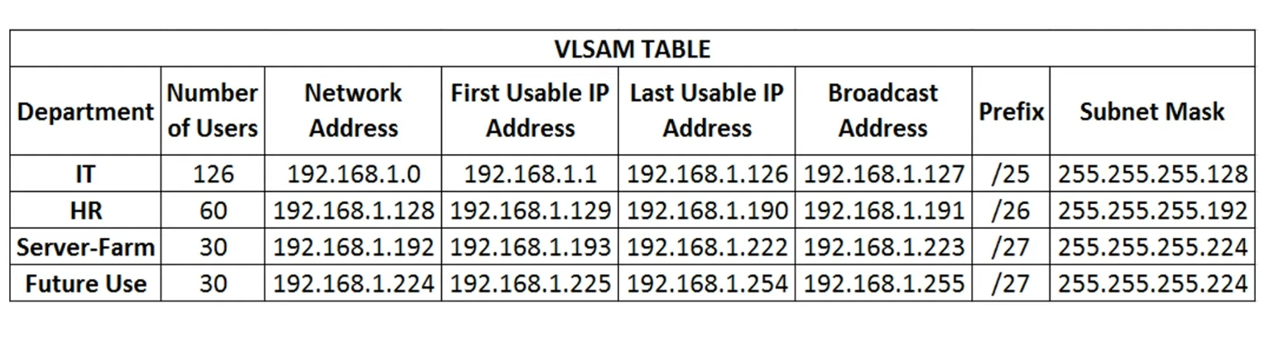
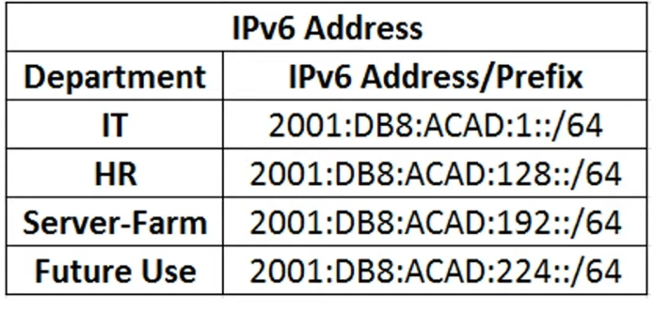
Module 1

Slide 10
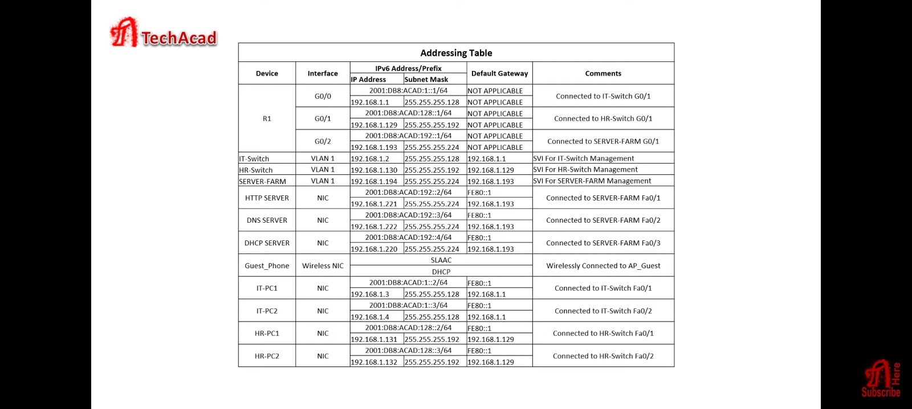
Module 2

Slide 11
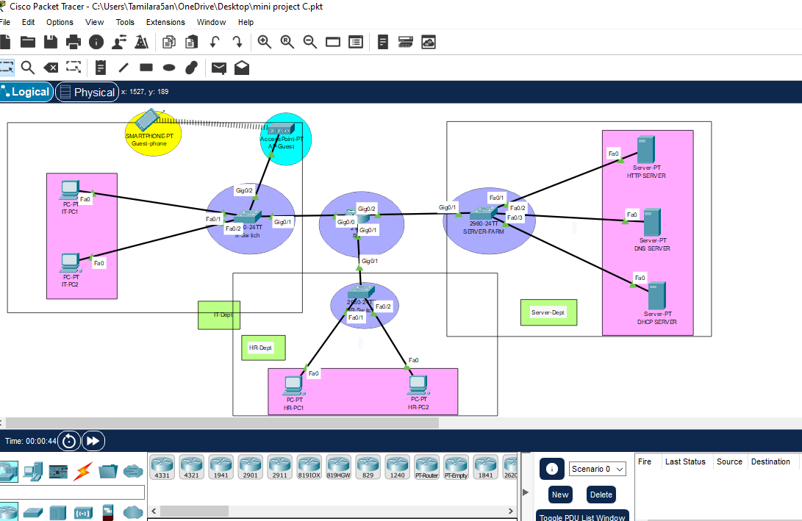
Module 4

Slide 12
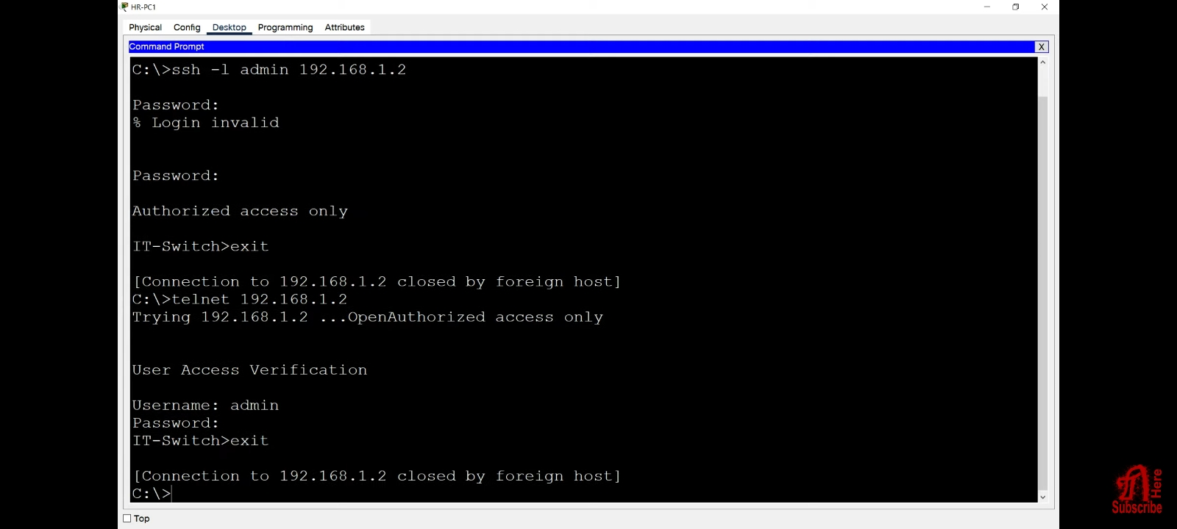
Sample Output

Slide 13
Conclusion
The proposed system also includes learning materials, assessment tools, and instructor support to enhance the learning experience. The learning materials such as instructional videos, online tutorials, and lab exercises can help students learn computer networking concepts. With the help of the system, students can gain practical experience in designing, configuring, and troubleshooting computer networks, and instructors can better engage and support their students in the learning process.

Slide 14
References
Cisco Certified Network Associate Study Guide fifth edition by Todd Lammle
http://www.ciscopress.com/articles/article.asp?p=328773&seqNum=3
Interconnecting Cisco Devices by Cisco
Computer Networks-A top-down approach by Kurose and Ross.
http://www.cisco.com/en/US/products/hw/routers/ps214/products _tech_note09186a00801f5d85.shtml
http://www.symantec.com/connect/forums/sep-client-switch-computer-mode-user-mode-automatically and-moving-other-group
http://en.wikipedia.org/wiki/Router_(computing

Slide 15
Thank you

